Slide 1
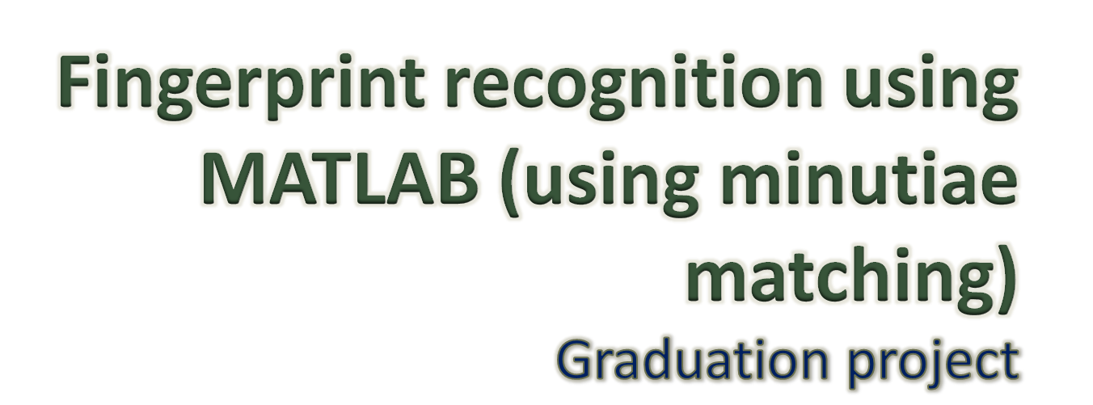


Slide 2
Contents
  Introduction
    Biometrics and fingerprint as recognition technique
  Algorithm
    System and algorithm design
    The process
  Evaluation and applications
  Simulation

Slide 3
Introduction
Personal identification is to associate a particular individual with an identity
To ensure the services are accessed by a legitimate user
Traditional methods could be compromised
Lack of security

Slide 4
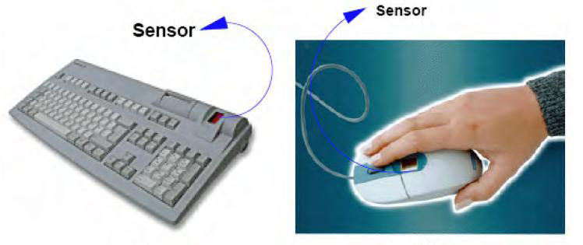
What are biometrics?
We all have unique personal attributes
Biometrics are individual physiological characteristics
It’s basically pattern
-recognition that
makes a personal
identification

Slide 5
Why biometrics?
Your password can be stolen, your face can’t!
More reliable than traditional
More secure
Saves time

Slide 6
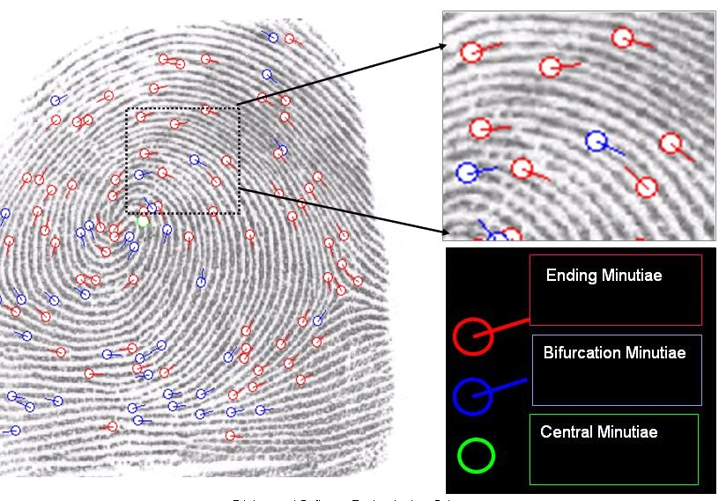
Fingerprints as biometrics
The major features in a print are called minutiae
Basic minutiae: ending
& bifurcation

Slide 7
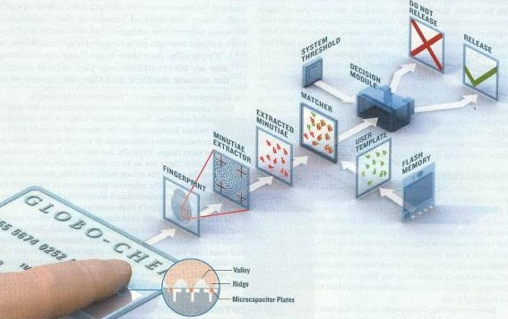
SYSTEM DESIGN
System level design
Algorithm design

Slide 8
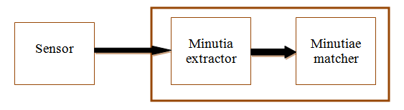
System level design
System consists of:

Slide 9
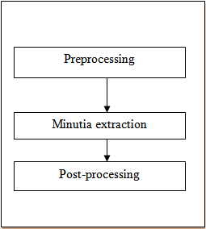
Algorithm Level Design
Image Enhancement
Image Binarization
Image segmentation
Thinning
Minutiae Marking
Remove False Minutiae

Slide 10
Algorithm Level Design
Minutiae matcher:
Specify reference minutiae
Image alignment
Minutiae match

Slide 11
PRE-PROCESSING
Image Enhancement
Image Binarization
Image segmentation

Slide 12
Preprocessing/ Image enhancement
Most important stage of project
There are lots of different ways to filter an image
The project was originally going to use edge detection

Slide 13
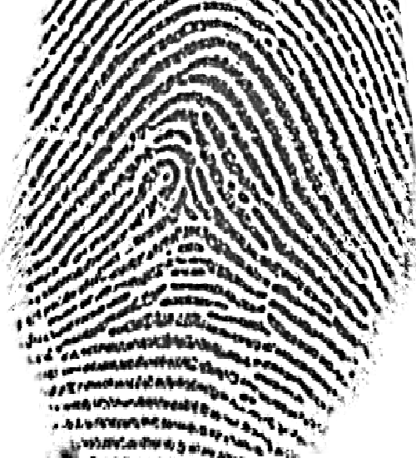
But after analysis, it turns out that for an image that looks like this:

Slide 14
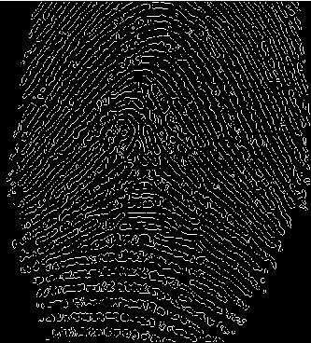
The result after edge detection would look like this:

Slide 15
This means that:
The result is an image with the borders of the ridges highlighted
This would call for the use of an extra step to fill out the shapes
And that would increase the complexity of the code
And would consume more processing time

Slide 16
So, I tried histogram equalization
It means to do a contrast adjustment on the image’s histogram
The intensities can be better distributed on the histogram

Slide 17

Function of histogram equalization
For a grayscale image {x}
let n_{i} be the number of occurrences of gray level i. Then the probability of an occurrence of a pixel of level i in the image is:
‘L’ is total number of gray levels in the image
‘n’ is total number of pixels in the image
‘p_{x}(i)’ is the image's histogram for pixel value i
Notes:
expand the pixel value distribution of an image so as to increase the perceptional information
to better detail in photographs that are over or under-exposed
This allows for areas of lower local contrast to gain a higher contrast

Slide 18

Follow up: histogram equalization
Also, the cumulative distribution function corresponding to p_{x} is:
The transform of the image is defined as:
The cdf of a pixel x represents the probability that a random pixel is less than or equal to x
Notes:
expand the pixel value distribution of an image so as to increase the perceptional information
to better detail in photographs that are over or under-exposed
This allows for areas of lower local contrast to gain a higher contrast
This increases the cdf of a pixel which would enhance the pixel’s distribution across the hist

Slide 19

Follow up: histogram equalization
After this process, the cdf of each pixel is normalized to [0,255]
cdf_{min} is the minimum value of the cumulative distribution function (in this case 1)
M × N is the image's number of pixels
L is the number of grey levels used (most cases L=256)
Notes:
expand the pixel value distribution of an image so as to increase the perceptional information
to better detail in photographs that are over or under-exposed
This allows for areas of lower local contrast to gain a higher contrast
This increases the cdf of a pixel which would enhance the pixel’s distribution across the hist

Slide 20
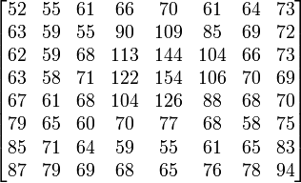
Example: histogram equalization
For a matrix with the following pixel values:
Notes:
expand the pixel value distribution of an image so as to increase the perceptional information
to better detail in photographs that are over or under-exposed
This allows for areas of lower local contrast to gain a higher contrast
This increases the cdf of a pixel which would enhance the pixel’s distribution across the hist

Slide 21
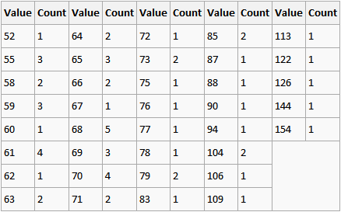
Follow up: Example
The histogram for this matrix (shown in table form) is:
Notes:
expand the pixel value distribution of an image so as to increase the perceptional information
to better detail in photographs that are over or under-exposed
This allows for areas of lower local contrast to gain a higher contrast
This increases the cdf of a pixel which would enhance the pixel’s distribution across the hist

Slide 22
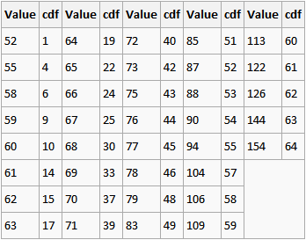
Follow up: Example
The cdf of the matrix is:
Notes:
expand the pixel value distribution of an image so as to increase the perceptional information
to better detail in photographs that are over or under-exposed
This allows for areas of lower local contrast to gain a higher contrast
This increases the cdf of a pixel which would enhance the pixel’s distribution across the hist

Slide 23
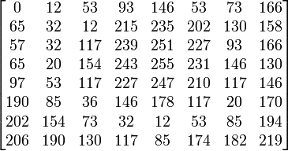
Follow up: Example
The normalized cdf becomes:
Notes:
expand the pixel value distribution of an image so as to increase the perceptional information
to better detail in photographs that are over or under-exposed
This allows for areas of lower local contrast to gain a higher contrast
This increases the cdf of a pixel which would enhance the pixel’s distribution across the hist

Slide 24
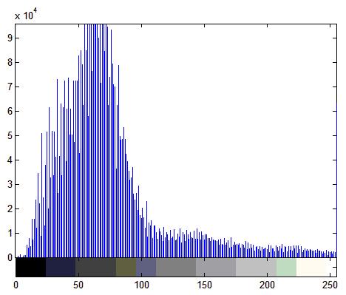
Follow up: histogram equalization
Now, applying that on an image with the following histogram:
Notes:
expand the pixel value distribution of an image so as to increase the perceptional information
to better detail in photographs that are over or under-exposed
This allows for areas of lower local contrast to gain a higher contrast
This increases the cdf of a pixel which would enhance the pixel’s distribution across the hist

Slide 25
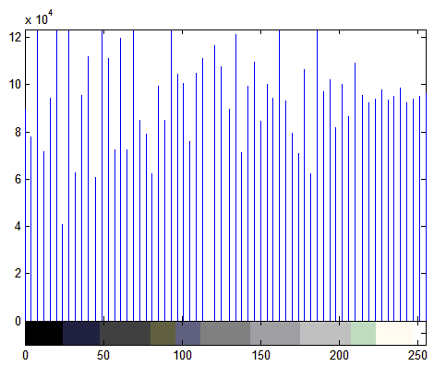
Follow up: histogram equalization
Would result in a histogram that looks like this:
Notes:
expand the pixel value distribution of an image so as to increase the perceptional information
to better detail in photographs that are over or under-exposed
This allows for areas of lower local contrast to gain a higher contrast
This increases the cdf of a pixel which would enhance the pixel’s distribution across the hist

Slide 26
This is good because…
It allows for areas of lower local contrast to gain a higher contrast
Brings out dim and dark features, but washes out bright stuff
Betters details in photographs that are over or under-exposed

Slide 27
Fast Fourier transform
The Fourier transform is done to find the frequency of the pixel
So the output would be an image in the frequency domain.

Slide 28
Follow up: Fast Fourier transform
The image is divided into blocks in order to enhance a specific block by its dominant frequencies
so, the process is to multiply the FFT of the block by its magnitude a set of times
Notes:
So, the output block would be we multiply the FFT of the block by its magnitude a set of times

Slide 29
Preprocessing/ Image binarization
This step is done to convert a 256-level image to a 2-level image
It’s done to differentiate image pixels from background
Because of variations in contrast, locally adaptive thresholding is used
Notes:
So, the output block would be we multiply the FFT of the block by its magnitude a set of times

Slide 30
Follow up: Image binarization
First, the image is divided into blocks (16x16)
The mean intensity value is calculated for each block
    Assume gray value of each pixel=g;
    if g > Mean(block gray value) , set g = 1;
    Otherwise g = 0
Notes:
So, the output block would be we multiply the FFT of the block by its magnitude a set of times

Slide 31
Preprocessing/ Image segmentation
Only a certain Region of Interest (ROI) is useful to be recognized for each fingerprint image
To extract the ROI, a two-step method is used; block direction estimation and ROI extraction
Notes:
So, the output block would be we multiply the FFT of the block by its magnitude a set of times

Slide 32

Follow up: Image segmentation
  Block direction estimation
  Get gradient x (gx),gradient y (gy)
    Estimate the according to:
  ROI extraction (Morphological Method)
    Close (shrink images and eliminate small cavities)
    Open (expands images and remove peaks introduced by background noise)
Notes:
Morphological method means: transform images according to size, shape, convexity, connectivity, and geodesic distance

Slide 33
FEATURE EXTRACTION
Image thinning
Minutiae marking

Slide 34
Feature extraction/ Image thinning
  To eliminate the redundant pixels of ridges till the ridges are just one pixel wide
  Morphological approaches:
    bwmorph(binaryImage,'thin',Inf)
This process is done by turning pixels off according to these conditions:
If there is at least 1 switch from on to off among boundary pixels
Not all 8-neighborhood pixels are on
Not a center nor ending pixel
P9 | P2 | P3
P8 | P1 | P4
P7 | P6 | P5

Slide 35
Follow up: Image thinning
  Filter by other Morphological operations to remove some H breaks and isolated points
  In this step, any single points (single-point ridges or single-point breaks) in a ridge are eliminated and considered processing noise
  Done using imerode and imfill

Slide 36
Feature extraction/ Minutiae marking
The concept of Crossing Number (CN) is used
CN is calculated by investigating the 8-neighborhood of each central pixel pixel (p) in order to determine the count of crossover occurrences
0 | 1 | 0
0 | 1 | 0
1 | 0 | 1
0 | 0 | 0
0 | 1 | 0
0 | 0 | 1
Bifurcation
Termination

Slide 37
Follow up: Minutiae marking
For a 3x3 window:
If p=1 and has only 1 one-value neighbor, then the central pixel is a ridge ending
If p=1 and has exactly 3 one-value neighbors, then the central pixel is a ridge branch
i.e. for a pixel P, if Cn(P) = = 1 it’s a ridge end and if Cn(P) = = 3 it’s a ridge bifurcation
(Cn being the number of 1-valued neighboring pixels)

Slide 38
POST-PROCESSING
False minutiae removal

Slide 39
False minutiae removal
Needed to get rid of noise introduced to image in:
Acquisition process (over or under inking)
Preprocessing stage

Slide 40
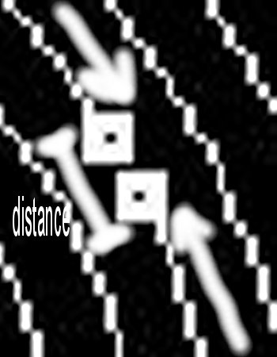

Examples: False minutiae removal
Two disconnected terminations
short distance
Two terminations at a ridge
are too close

Slide 41
Follow up: False minutiae removal
There are 7 cases of false minutiae
(length of block=average inter-ridge distance)
a spike piercing into a valley
a spike falsely connects two ridges

Slide 42
Follow up: False minutiae removal
two near bifurcations located in the same ridge
two near endings
just like previous but with extra ridge
one short ridge
three near endings

Slide 43
MINUTIAE MATCH
Alignment
Matching

Slide 44
Minutiae match/ Alignment
To match 2 prints, determine their reference minutiae (most similar pair/at 0.8 threshold) using similarity equation:
S = ∑^{m}_{i=0}x_{i}X_{i}/[∑^{m}_{i=0}x_{i}²X_{i}²]^0.5
where (x_{i~}x_{n}) and (X_{i~}X_{N} ) are the set of minutia for each fingerprint image respectively
m is minimal one of the n and N value (n & N are total number of minutiae in each print)

Slide 45
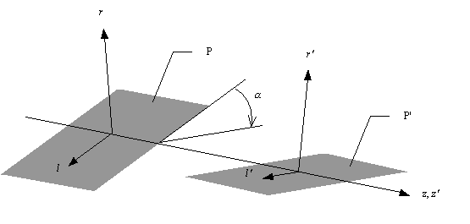
Follow up: Alignment
Now, the reference minutia is the origin point of the coordinate system, and the x & y coordinates are found using its orientation angle.

Slide 46
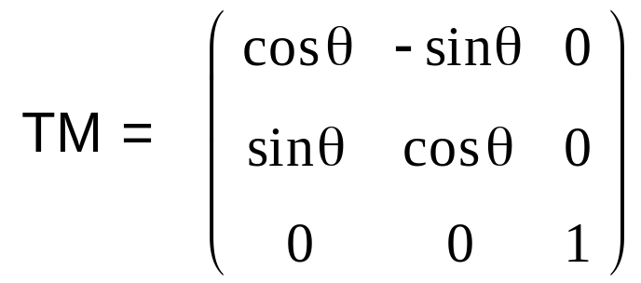
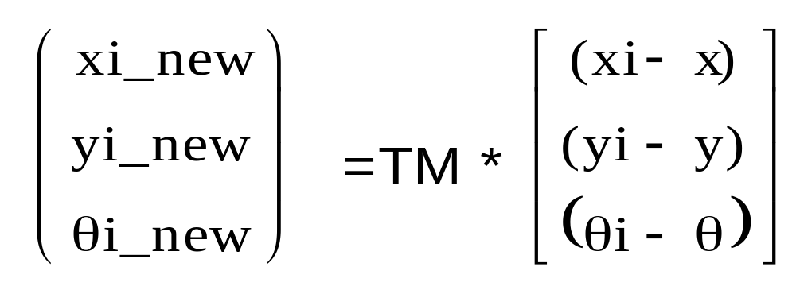
Follow up: Alignment
All other minutiae are then aligned to the new coordinate system, and component of their vectors can be found using the transform matrix:
and the new values of x & y become:

Slide 47
Minutiae match/ Matching
Adaptive matching is used, not all parameters are exactly same
Achieved by placing a bounding box around each template minutia
If the minutia to be matched is within the rectangle box and difference between them is very small, then the two minutiae are regarded as a matched minutia pair

Slide 48
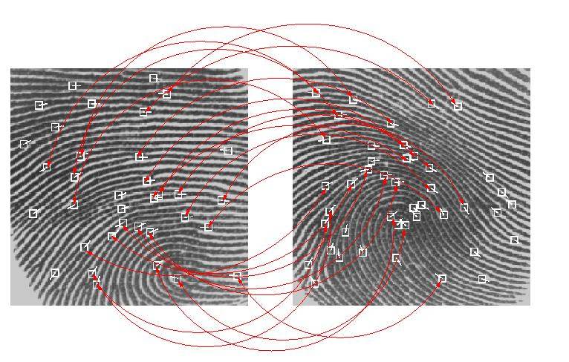
Match or Non-match?

Slide 49
Follow up: Match or Non-match?
The final match ratio is:
Match Score = Num(Matched Minutia)
Max(Num Of Minutia(image1,image2))
The score ranges from 0 to 100
If the score is larger than a pre-specified threshold, the two fingerprints are from the same finger.

Slide 50
SYSTEM EVALUATION AND APPLICATIONS

Slide 51
System evaluation (FRR & FAR)
This step is done using the False Reject Rate (FRR) and the False Accept Rate (FAR)
(%) FAR=(FA/N)*100
Where FA= number of incidents of false acceptance
& N=total number of samples
(%) FRR=(FR/N)*100
Where FR=number of incidents of false rejections

Slide 52
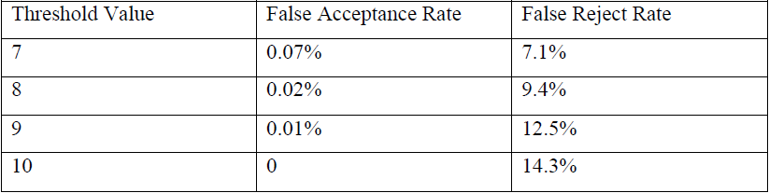
Follow up: System evaluation
For a database of 10 prints, the results of the evaluation were as follows:

Slide 53
Follow up: System evaluation
As we can see from the results, the best percentage of match to be chosen as a threshold for a match/non-match comparison is 80%

Slide 54
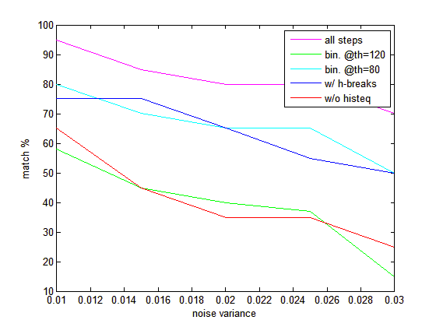
System evaluation (project steps)

Slide 55
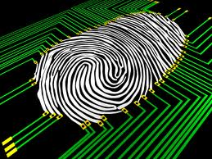
Applications
There are many applications known and yet to be developed such as:
Prescription fulfillment
Time and Attendance
Finance and Banking
account access
Law Enforcement

Slide 56
THANK YOU ☺
“The road of life twists and turns and no two directions are ever the same. Yet our lessons come from the journey, not the destination.”- Don Williams, Jr.

